Slide 1
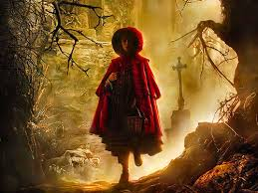
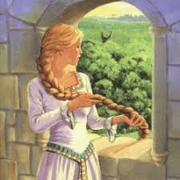
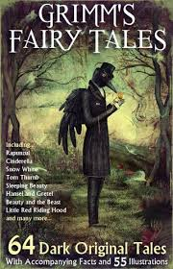
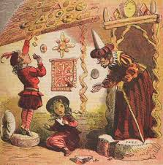
Grimm’s Tales auditions!
Monday 14th October 3.15pm-4.30pm
D2 – All years welcome
You don’t need to prepare anything – just come along
In order to participate you must be available for rehearsals every Monday after school until 4.30pm until early February
You also need to be available all day on Saturday 1st February
The performances are on the evenings of 5th and 6th February
Any questions see Ms Ward in Drama

