Slide 1
Workplace Campion
Dear Parent/Carer,
This presentation we have shared with students in tutor time is about expectations and conduct appropriate for a professional establishment (workplace).
We would like to remind students in particular that no hoodies are allowed to be worn to school. We are going to have to start confiscating these again if students continue bringing these to school. An outdoor coat is allowed to and from school and at break times, but coats must be removed in buildings and hoodies are not part of our uniform policy.
Thank you
Mr S King

Slide 2
#WorkplaceCampion
Learning question: Are you Work Ready? Exploring what is acceptable in the workplace and why we don’t allow it in school.

Slide 3
Would you give this person a job?
https://www.youtube.com/watch?v=zV1zK8zRCPo

Slide 4
No, neither would we.
In fact there are students in our school right now who we wouldn’t give a job to.
Why?

Slide 5
What does your language say about you? Swearing so loud that visitors can hear.

Slide 6
What happens when things are said that shouldn’t be?
Quote from a newspaper article:
Last year brought a situation I thought I might never see, someone lost their job due because they used inappropriate language. This was a first to me, perhaps there have been others but since it happened in a sport I have an interest in, football, I took notice. The ‘off air’ racist comment about a black Chelsea player by football pundit Ron Atkinson became a media hot potato last year. His faux pas forced his resignation at ITV and as a writer for the Guardian but he is not alone in making gaffs of this kind. Atkinson’s fall from grace could easily happen to other professionals and leave an organisation with a damaged reputation and poor morale.’ This is a clear example of what happens when bad language is heard in the workplace. Not only was the language offensive but it was also racist.

Slide 7
What do religions say about swearing?
“ Do not let any unwholesome talk come out of your mouths, but only what is helpful for building others up according to their needs, that it may benefit those who listen”. (Christianity)
”swearing is not only a matter between two people, it's a bad behaviour that Allah forbade, so we shouldn't do it”. (Islam)

Slide 8
What do employers say?
1 Employer: Everyone has heard offensive language at work. Some have used it and a few people employ it regularly, seemingly without a second’s thought. It has no place in any organisation that is genuinely striving to achieve a friendly and productive working environment. Offensive language upsets many people, and can distract them from their work. It also calls into question the attitude and ethics of the person who’s using the language.
Monster.co.uk: Using bad language at work comes across unprofessional and can lead to getting fired.

Slide 9
What else? What doesn’t fit in at work?

Slide 10
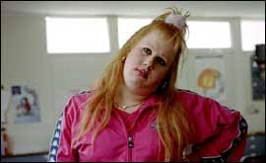
The dreaded hoops…

Slide 11
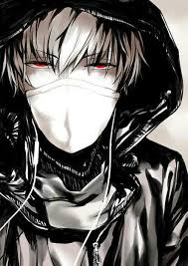
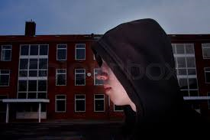
The boy who will not listen to you and has half his face covered up with a hoody…

Slide 12
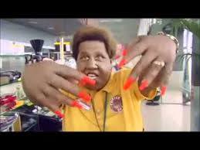
The inappropriate nails. Would you let this woman operate on you? Would you let this woman with those nails operate machinery?

Slide 13
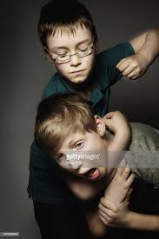
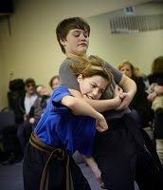
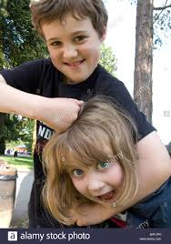
Would you want these boys as men in your workplace? Hands off each other!

Slide 14
From the NHS employee dress code
To maintain compliance with ‘naked below the elbows’ wrist watches must not be worn. One pair of stud earrings may be worn however hoops and dangling earrings must not be worn due to the attendant health and safety risks. Stretchers used in the ear lobe must be with a flesh coloured plug. Theatre staff must remove earrings/piercings prior to working in the theatre as there is a risk these may fall into patients surgical wound sites. No necklaces, chains, bracelets or ankle chains to be worn, however recognised medi-alerts are permitted providing the individual staff member has discussed this with their line manager and Occupational Health. One plain band ring can be worn

Slide 15
This is a work place
Hooped earrings which dangle from the ear are banned. This will be a Head of Year focus for the coming weeks.
Swearing reflects your lack of vocabulary. If we hear it, it is offensive.
#hearit#stopit
Don’t say it loud enough for us to hear. Or find another word…..

Slide 16
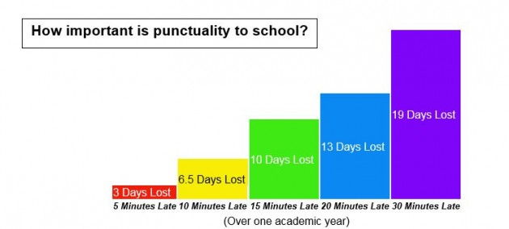
Finally punctuality….no loitering.

Slide 17
So why all of this?
Campion is a workplace.
We need to prepare you. Identity is one thing. Discreet make up allowed. Discreet nail colour allowed. Small earrings allowed.
Hoodies and earphones are not workplace appropriate.
Pushing the boundaries to the long nails and hooped earrings is unprofessional and inappropriate and is not allowed.
We cannot ban you from swearing with your mates/at home. But we can be offended by it in school. If we are offended by it, you need to stop. Say it loud enough for us/others to hear and we will sanction.

